Slide 1
WORKING OF AN ACID BUFFER
WEI MEI

Slide 2
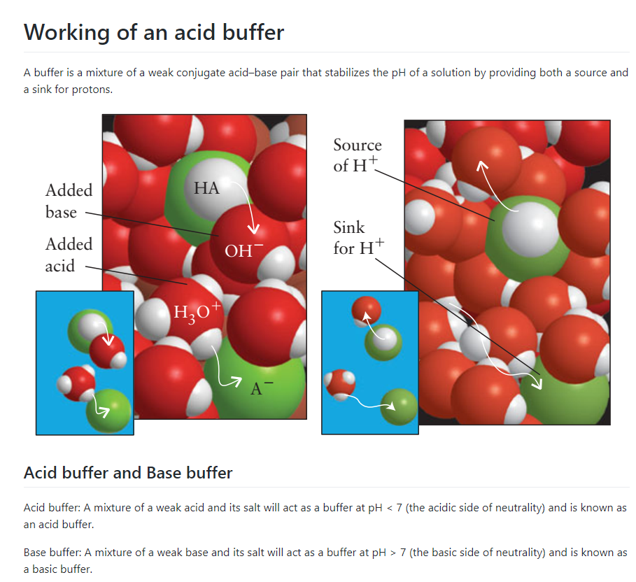
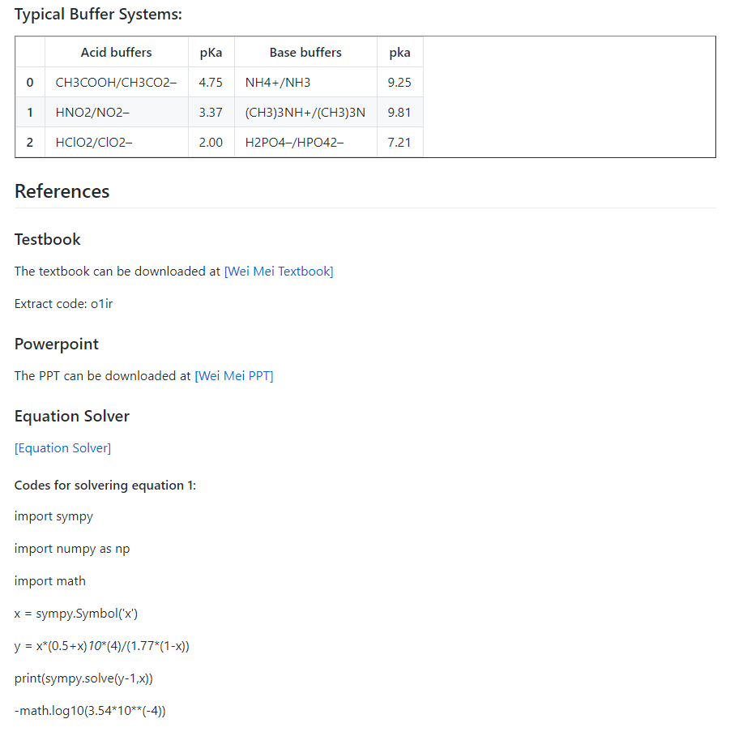
CLASS WEBSITE
https://github.com/nickcafferry/Working-of-an-acid-buffer/blob/master/README.md

Slide 3
BUFFERS
Definition: a solution in which the pH resists change when small amounts of strong acids or bases are added.
Acid buffer: A mixture of a weak acid and its salt will act as a buffer at pH < 7 (the acidic side of neutrality) and is known as an acid buffer.
Base buffer: A mixture of a weak base and its salt will act as a buffer at pH > 7 (the basic side of neutrality) and is known as a basic buffer.

Slide 4
CONDITIONS
Weak acid / Weak base – Conjugate to one another
HCOOH/HCOO-
Approximately equal amount – at the same magnitude
Substantial amount – (High concentration) e.g. 1mol/L

Slide 5
TYPICAL ACID BUFFERS AND BASE BUFFERS
Acid buffers | pKa | Base buffers | pKa
CH3COOH/CH3CO2– | 4.75 | NH4+/NH3 | 9.25
HNO2/NO2– | 3.37 | (CH3)3NH+/(CH3)3N | 9.81
HClO2/ClO2– | 2.00 | H2PO4–/HPO42– | 7.21

Slide 6
WILL IT WORK?
Suppose 0.10 mol of a strong acid such as HCl is added to the 1 liter of pure water, calculate the pH of the resulting solution.
pH = 7 → pH = 1
Suppose 0.10 mol of a strong acid such as HCl is added to the 1mol/l HCOOH and 0.5 mol/l HCOONa 1 liter solution (Ka = 1.77 x 10^-4), calculate the pH of the resulting solution.
? → ?

Slide 7
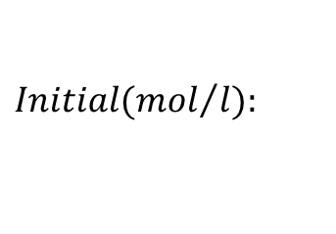




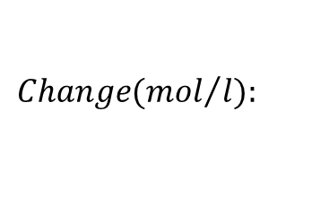



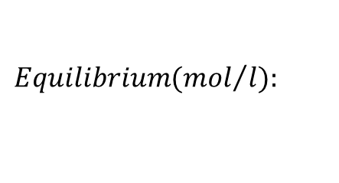



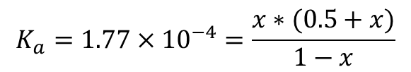

WILL IT WORK?
Suppose 0.10 mol of a strong acid such as HCl is added to the 1mol/l HCOOH and 0.5 mol/l HCOONa 1 liter solution (Ka = 1.77 x 10^-4), calculate the pH of the resulting solution.
Before the addition of HCl:
pH = 3.451

Slide 8
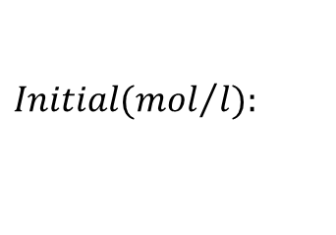




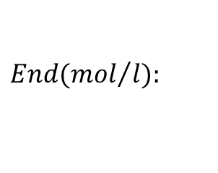




WILL IT WORK?
Suppose 0.10 mol of a strong acid such as HCl is added to the 1mol/l HCOOH and 0.5 mol/l HCOONa 1 liter solution (Ka = 1.77 x 10^-4), calculate the pH of the resulting solution.
After the addition of HCl:

Slide 9
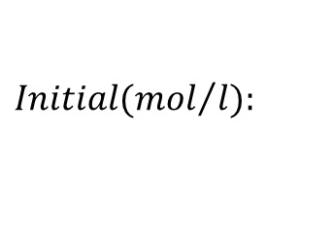




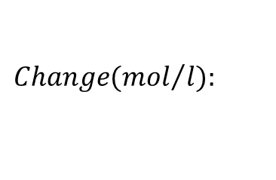



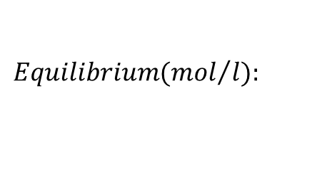



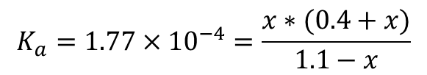

WILL IT WORK?
Suppose 0.10 mol of a strong acid such as HCl is added to the 1mol/l HCOOH and 0.5 mol/l HCOONa 1 liter solution (Ka = 1.77 x 10^-4), calculate the pH of the resulting solution.
After the addition of HCl:
pH = 3.31

Slide 10
WILL IT WORK?
IT WORKS!
Suppose 0.10 mol of a strong acid such as HCl is added to the 1 liter of pure water, calculate the pH of the resulting solution.
pH = 7 → pH = 1
Suppose 0.10 mol of a strong acid such as HCl is added to the 1mol/l HCOOH and 0.5 mol/l HCOONa 1 liter solution (Ka = 1.77 x 10^-4), calculate the pH of the resulting solution.
pH = 3.451 → pH=3.31

Slide 11
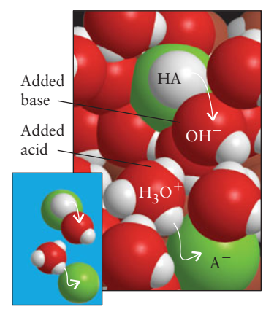
WHY?
To understand why, consider the dynamic equilibrium between a weak acid and its conjugate base in water:
When a few drops of a strong acid are added to such a solution, the newly arrived H+ ions transfer protons to the A- ions to form HA and H2O molecules.
Because the added H+ ions are removed by the A- ions, the pH remains almost unchanged.
If a small amount of strong base is added instead, the incoming OH- ions remove protons from the HA molecules to produce A- ions and H2O molecules.

Slide 12
HOMEWORK 1
Consider the equilibrium:

